Slide 1
TKIDEC064
Develop a Bluetooth Controlled Robot
-DINESH ARJUN P
-VARSHINI PJ

Slide 2
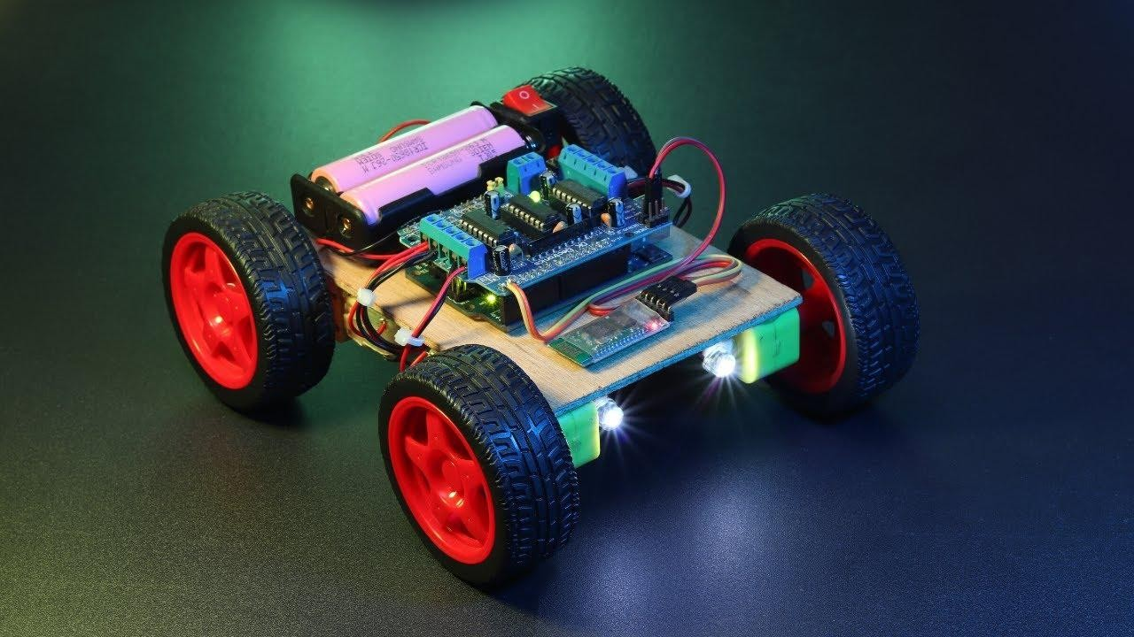
ABSTRACT
▶ The Bluetooth Controlled Robot project focuses on developing a robot that can be controlled wirelessly using Bluetooth technology. The robot is equipped with a Bluetooth module that enables communication with a mobile device. Users can control the robot's movements through a dedicated application installed on their mobile device. The project aims to provide a user-friendly and convenient interface for controlling the robot remotely, expanding its capabilities and enhancing its versatility.

Slide 3
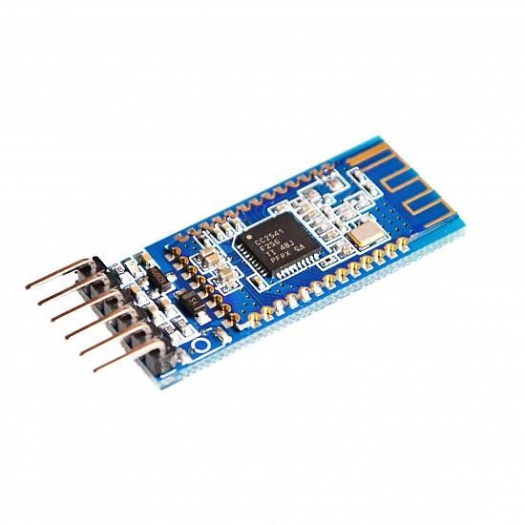
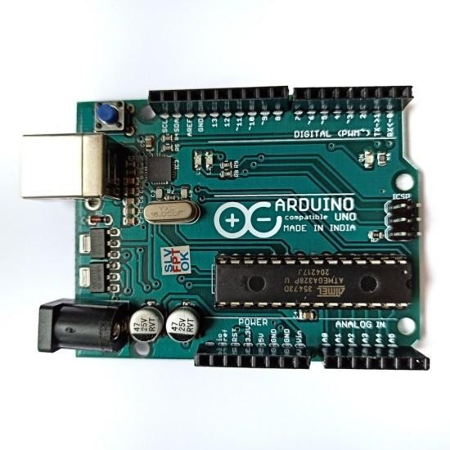
COMPONENTS USED
▶ ARDUINO
▶ BATTERY
▶ BREADBOARD
▶ BLUETOOH MODULE
▶ DC 3-6V BO GEAR MOTOR WITH PLASTIC TIRE WHEEL
▶ JUMPER WIRES

Slide 4
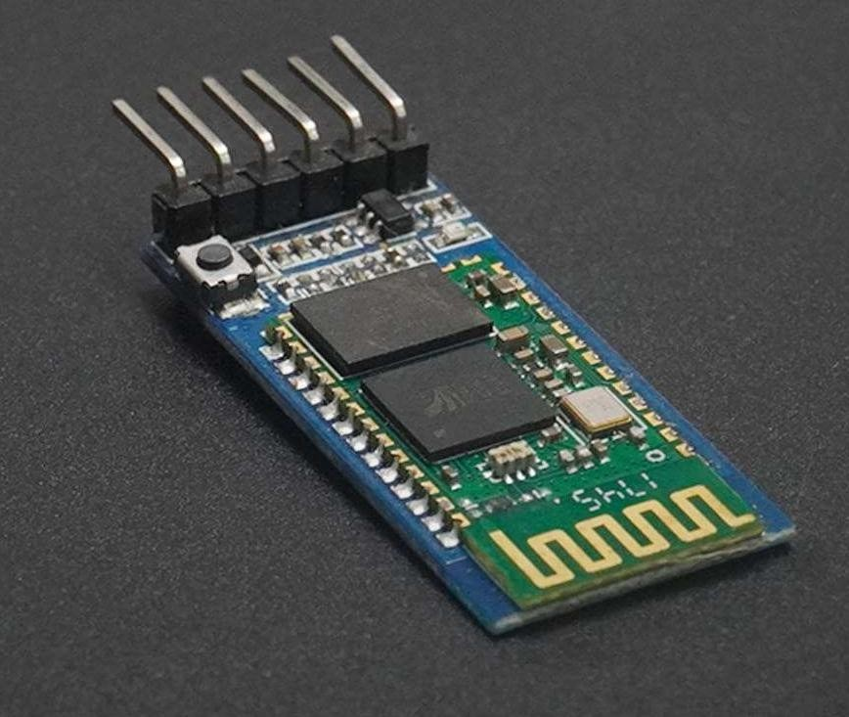
BLUETOOH MODULE
The HC-05 is a class 2 Bluetooth module designed for transparent wireless serial communication. It is pre-configured as a slave Bluetooth device. Once it is paired to a master Bluetooth device such as PC, smart phones and tablet, its operation becomes transparent to the user. All data received through the serial input is immediately transmitted over the air. When the module receives wireless data, it is sent out through the serial interface exactly at it is received. No user code specific to the Bluetooth module is needed at all in the user microcontroller program.

Slide 5
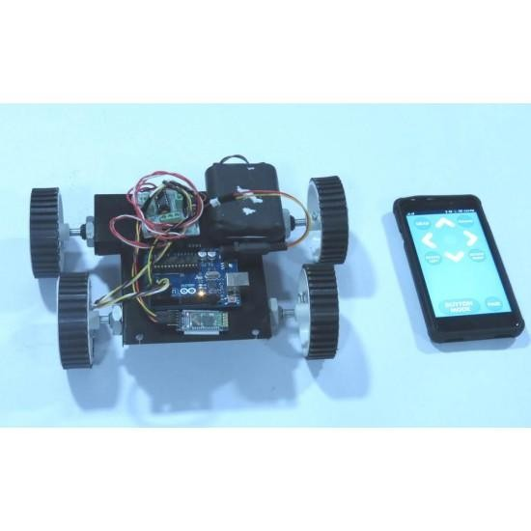
METHADOLOGY
Assemble the mechanical structure of the robot and connect the motors to the Arduino board.
Establish the power supply by connecting the battery to the Arduino and motors.
Integrate the Bluetooth module with the Arduino for wireless communication.
Develop the Arduino code to receive Bluetooth commands and control the motors accordingly.
Use the breadboard for circuit connections, ensuring proper wiring between components.

Slide 6
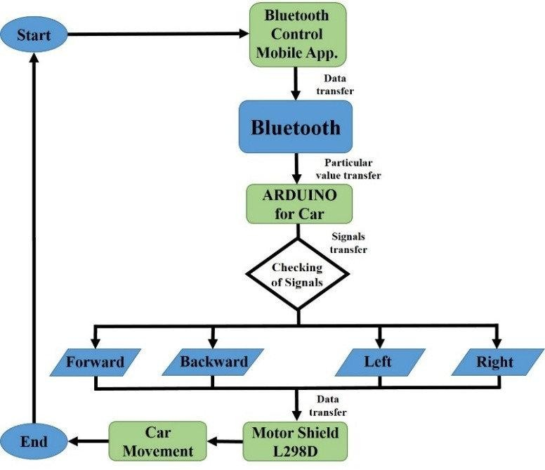
FLOW CHART

Slide 7
WORKING MODEL
Robot chassis: This is the physical structure of the robot that houses all the components. Motors: DC motors or servo motors to provide the robot with the ability to move.
Motor driver: An electronic circuit that controls the motors based on the input signals.
Microcontroller: A programmable microcontroller such as Arduino or Raspberry Pi to control the robot's functions.
Bluetooth module: A Bluetooth module such as HC-05 or HC-06 to establish a wireless connection between the robot and the controlling device.
Power supply: Batteries or a power source to provide electrical power to the robot. Wheels: Wheels or tracks for the robot's movement.
Additional sensors (optional): Depending on your project requirements, you may include additional sensors such as ultrasonic sensors or line-following sensors for obstacle detection or line-following capabilities.

Slide 8
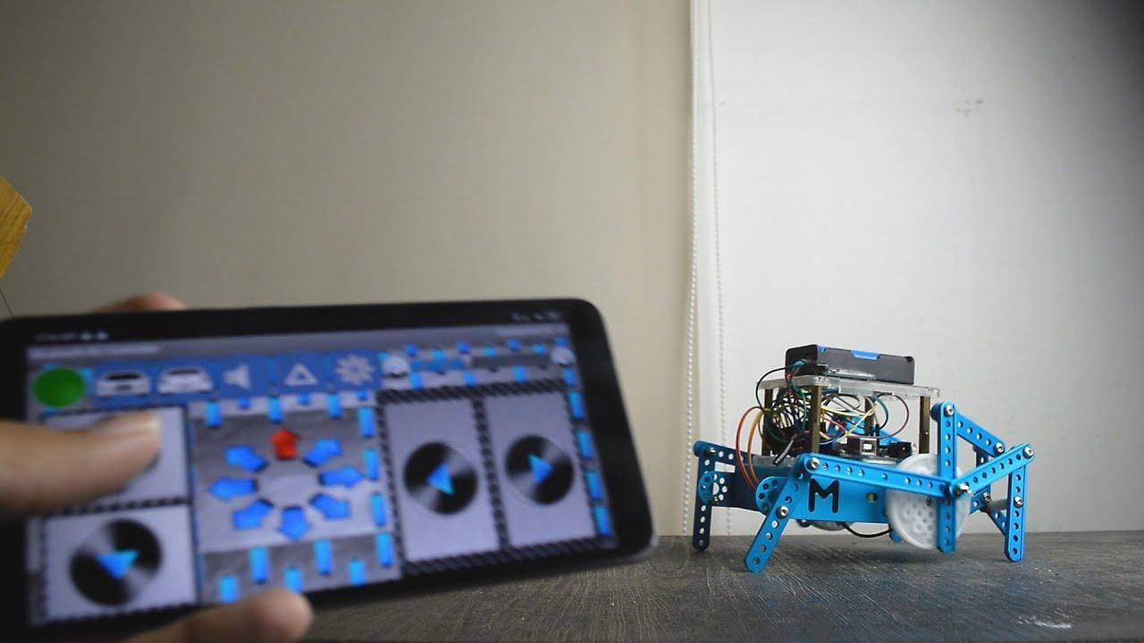
CONCLUSION
In conclusion, building a Bluetooth-controlled robot provides an engaging opportunity to develop mechanical, electrical, and programming skills. By assembling the robot chassis, integrating motors, a motor driver, and a microcontroller, and incorporating a Bluetooth module, a wireless control system is established. With proper programming, the robot's movements can be controlled via a Bluetooth-enabled device. The project allows for customization by adding sensors and expanding functionalities. It provides valuable hands-on experience in robotics and wireless communication. Overall, building a Bluetooth-controlled robot is a rewarding project that fosters learning, problem-solving, and sets the foundation for further exploration in the field of robotics.

Slide 9
THANK YOU

